Slide 1



PRESENTATION ON
OLiST eCommerce-Analytics - DATA SET
PRESENTED BY :
Arabinda Sahoo

Slide 2
INTRODUCTION
E-commerce growth demands data-driven decisions to improve customer experience and operational efficiency.
This project analyzes the List Brazilian E-commerce Dataset covering orders, customers, sellers, products, payments, reviews, delivery timelines, and geolocation.
Despite strong sales, List faces challenges such as delivery delays, high logistics costs, uneven seller performance, and low customer ratings.
The analysis aims to uncover key patterns in customer behavior, delivery performance, payment trends, and product categories.
Insights from this study support logistics optimization, seller improvement, and better customer satisfaction.

Slide 3
Dataset Overview
The dataset contains ~120,000 rows and ~45 columns, created by merging multiple List e-commerce datasets.
It represents Brazilian online marketplace transactions, covering orders, customers, sellers, products, payments, reviews, delivery, and geolocation.
Key features include order status, product category, price, freight value, payment details, and review scores.
The dataset consists of categorical, numerical, and datetime columns, suitable for business and operational analysis.

Slide 4
KEY COLUMNS OVERVIEW
order_id – Unique identifier for each order
order status – Current status of the order (delivered, canceled, etc.)
order status – Date and time when the order was placed
order status – Date when the order was delivered to the customer
customer state – State where the customer is located
customer state – Product category in English
price – Price of the product
freight value – Shipping cost for the order item
seller state – State where the seller is located
payment type – Payment method used by the customer
review score – Customer rating for the order (1 to 5)
delivery days – Number of days taken to deliver the order

Slide 5
Problem Statement
The List dataset represents Brazilian e-commerce transactions, including orders, customers, sellers, products, payments, reviews, delivery, and geolocation data.
Despite high sales volume, List faces challenges such as delivery delays, high logistics costs, low customer ratings, cancellations, and regional inefficiencies.
The objective of this analysis is to understand delivery performance, customer satisfaction, sales trends, payment behavior, and geographical patterns using the merged dataset.
Insights from this analysis aim to identify operational bottlenecks, improve logistics efficiency, enhance seller performance, and increase customer satisfaction.

Slide 6
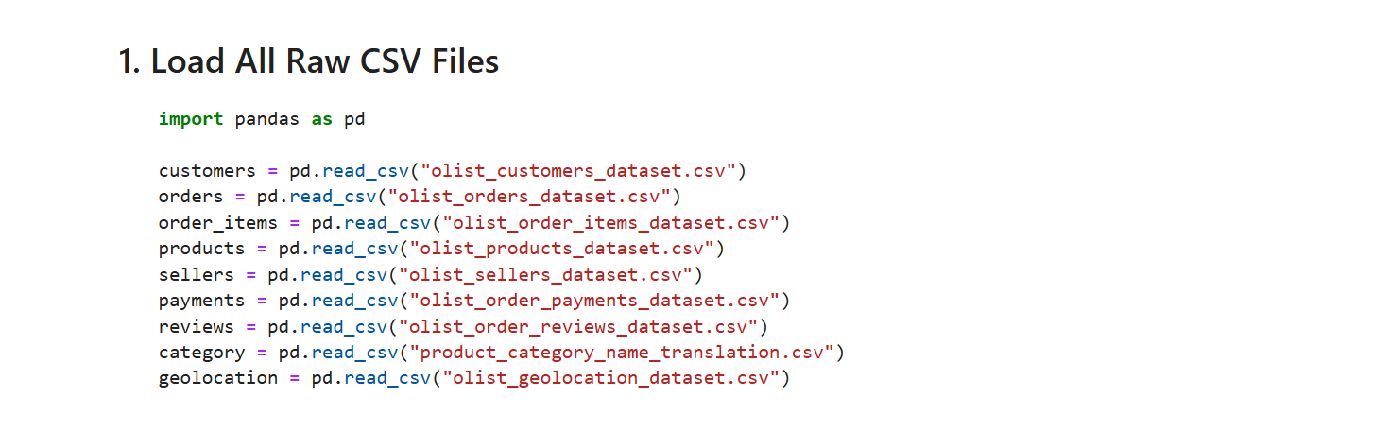
Reading Dataset
This step loads all raw CSV files related to customers, orders, products, sellers, payments, reviews, categories, and geolocation using pandas.
Loading these datasets separately is necessary before merging them into a single master dataset for analysis.

Slide 7
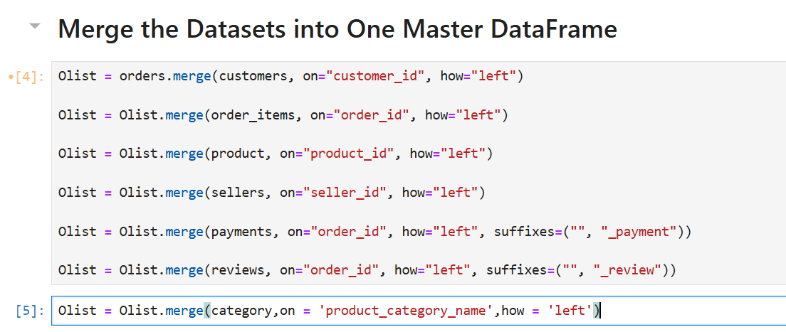
MERGE THE DATASETS
This step merges all individual List datasets into a single master Data Frame using common keys such as order_id, customer, productid, and Selerix.
Left joins are used to preserve all order records while enriching them with customer, product, seller, payment, review, and category details for complete analysis.

Slide 8
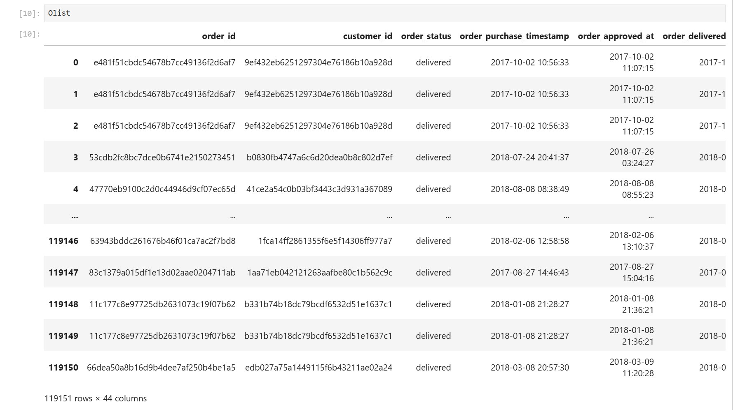
DATA SET

Slide 9
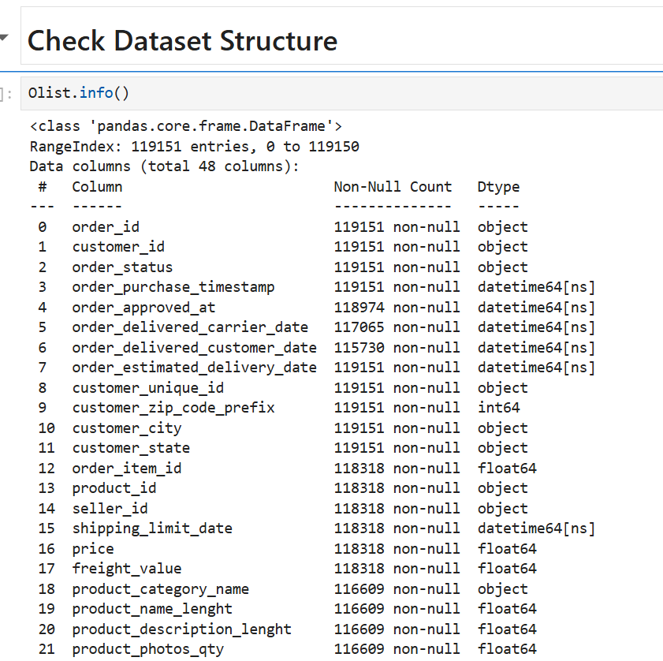
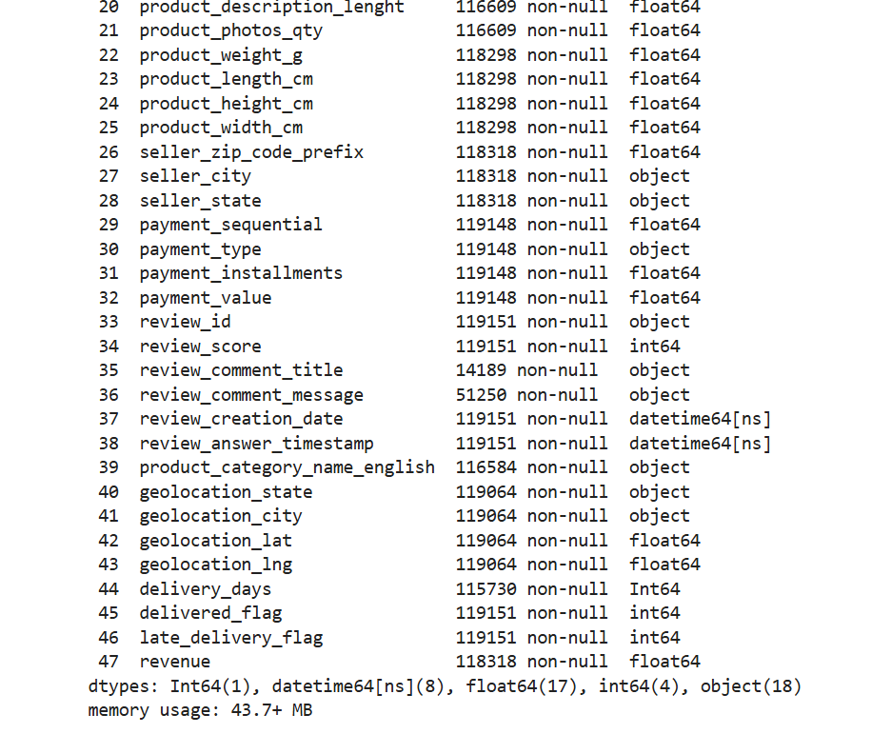
CHECK DATA STRUCTURE

Slide 10
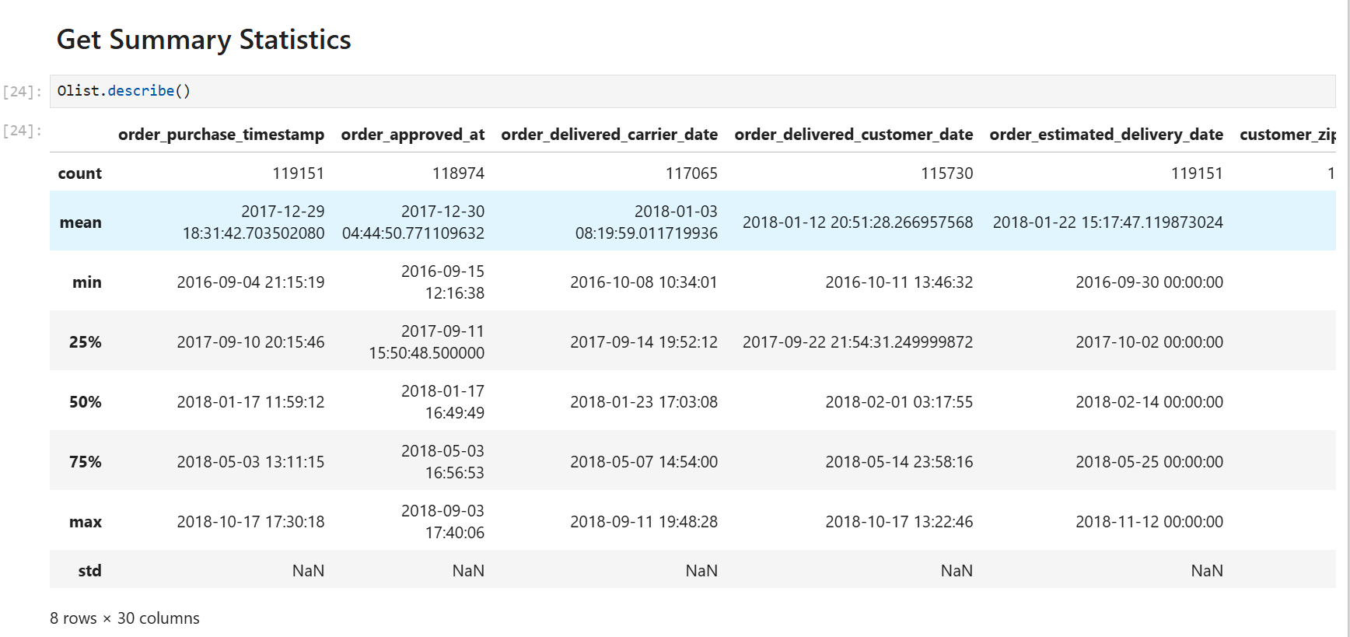
STATISTICS SUMMARY

Slide 11
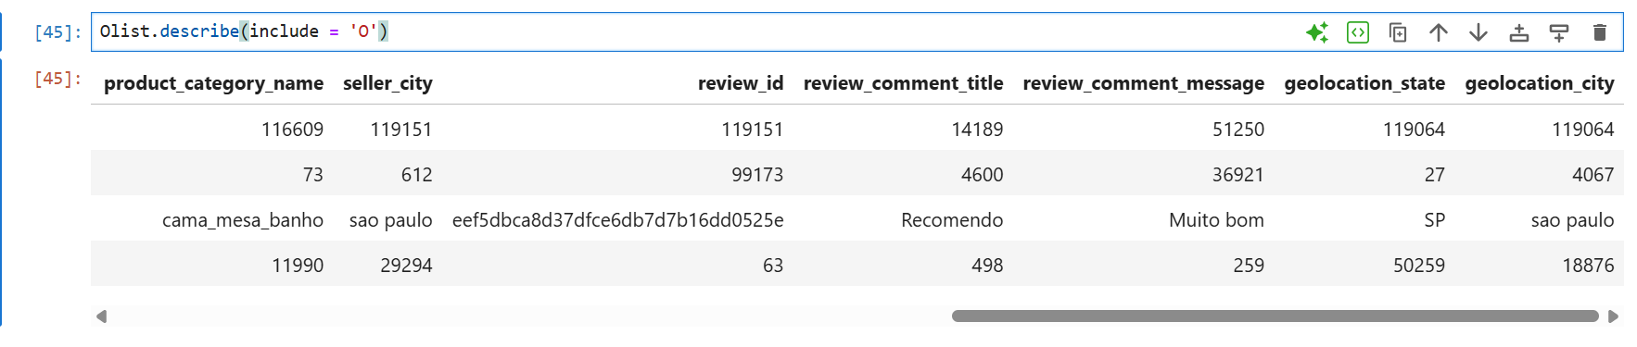
Numerical Summary (describe())
Prices, freight values, and delivery days show high variation and right-skewness, indicating diverse order sizes and shipping costs.
Delivery days contain long tails, confirming the presence of delayed orders.
Product weight and dimensions have outliers, which are expected in an e-commerce marketplace.
Categorical Summary (describe('O'))
Most orders are successfully delivered, making it the dominant order status.
A small number of product categories, states, and sellers account for the majority of transactions.
Credit card is the most commonly used payment method, and many reviews lack text feedback.

Slide 12
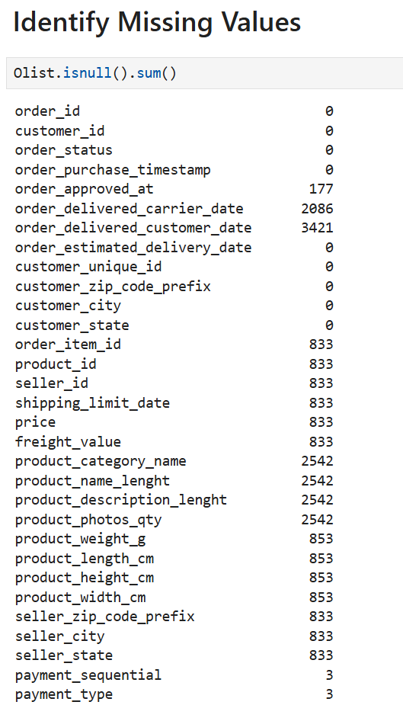
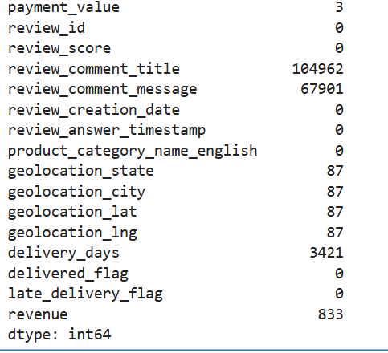
Identify MISSING VALUES

Slide 13
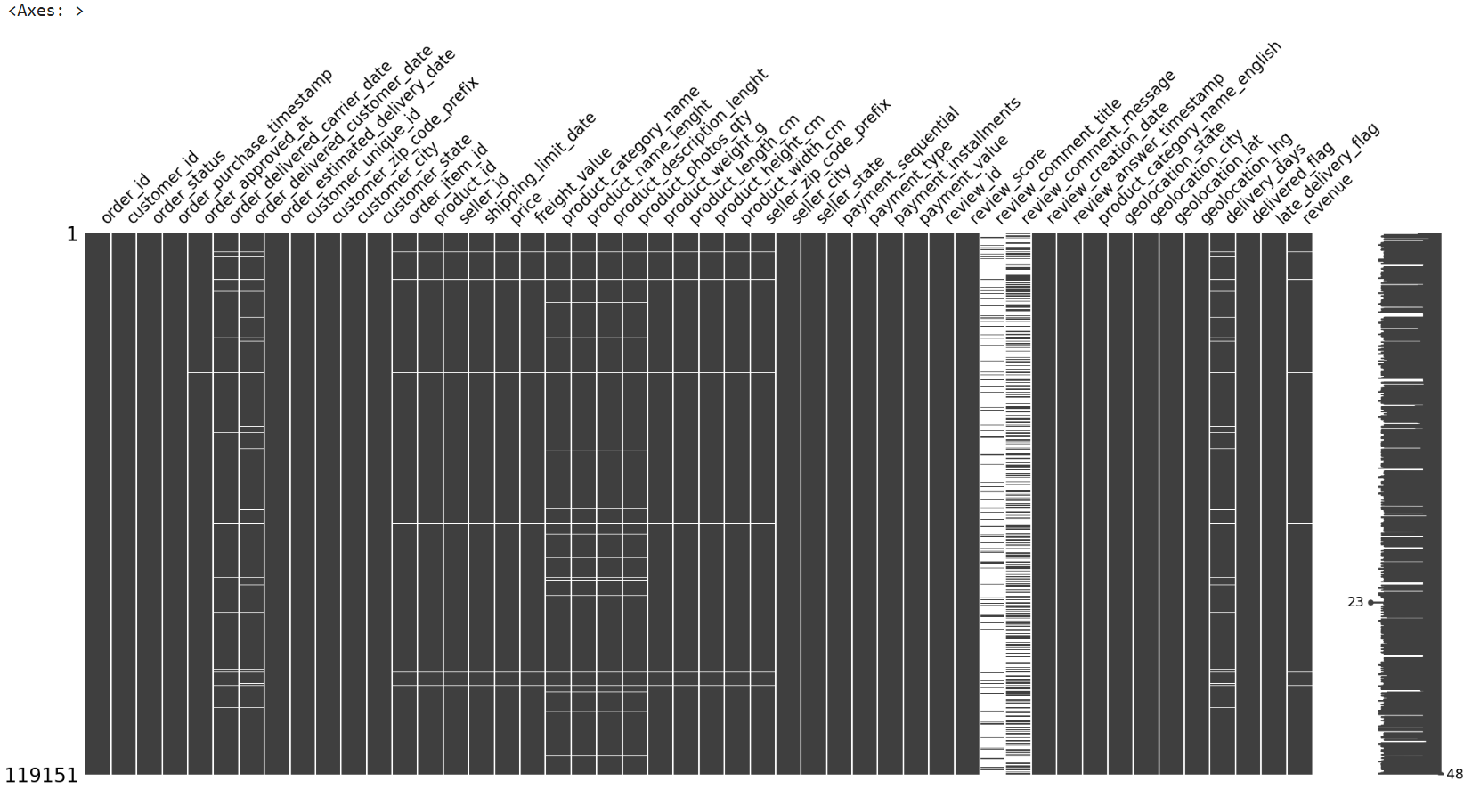
Missing values are mainly concentrated in delivery-related and review comment columns, representing undelivered orders and customers who did not leave written feedback.
These missing values are expected in real-world e-commerce data and reflect actual business situations rather than data quality issues.

Slide 14
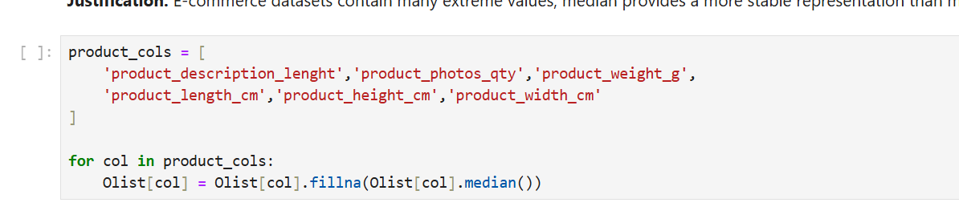
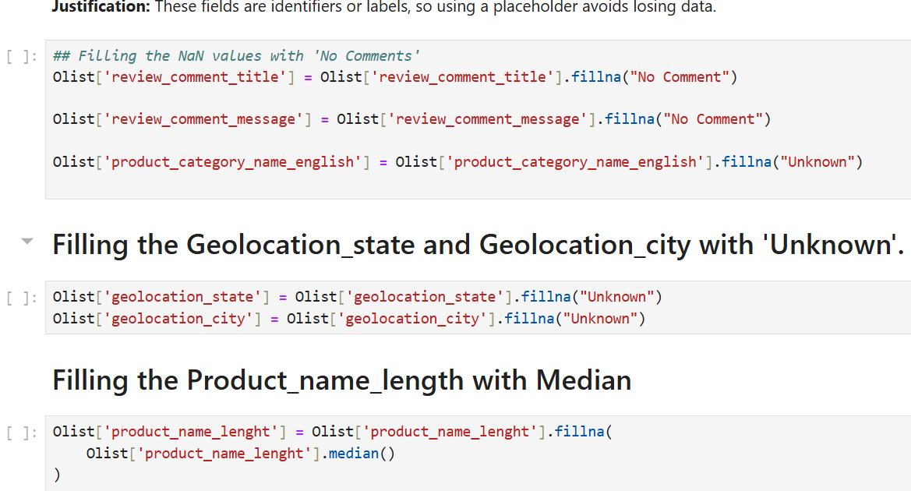
HANDLING MISSING VALUES
Missing numerical product attributes were filled using the median to reduce the impact of outliers and preserve realistic values.
Categorical and text fields were filled with meaningful labels such as “Unknown” and “No Comment”, ensuring data completeness without distorting business meaning.

Slide 15
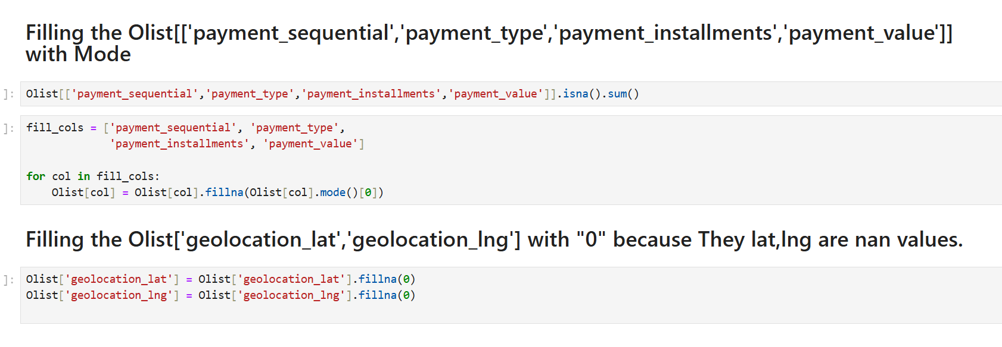
Payment-related columns were filled using the mode, preserving the most common payment behavior and avoiding distortion of transaction patterns.
Missing geolocation latitude and longitude values were set to 0 to maintain dataset completeness while indicating unavailable location information.

Slide 16
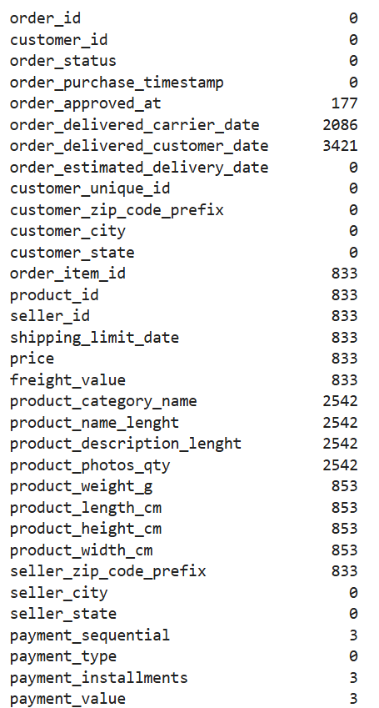
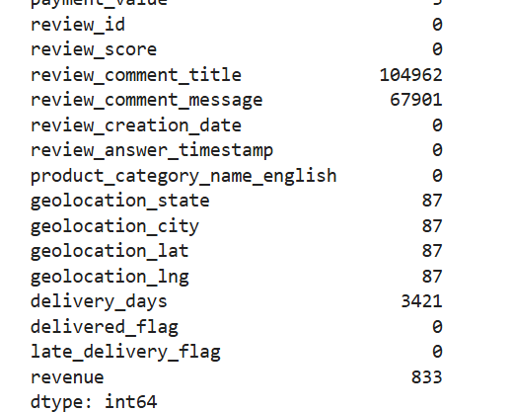
Checking Null values After Preprocessing
After preprocessing, all critical columns have been successfully handled, and the dataset contains no missing values that impact analysis.
This confirms that the dataset is clean, consistent, and ready for exploratory analysis and business insights

Slide 17
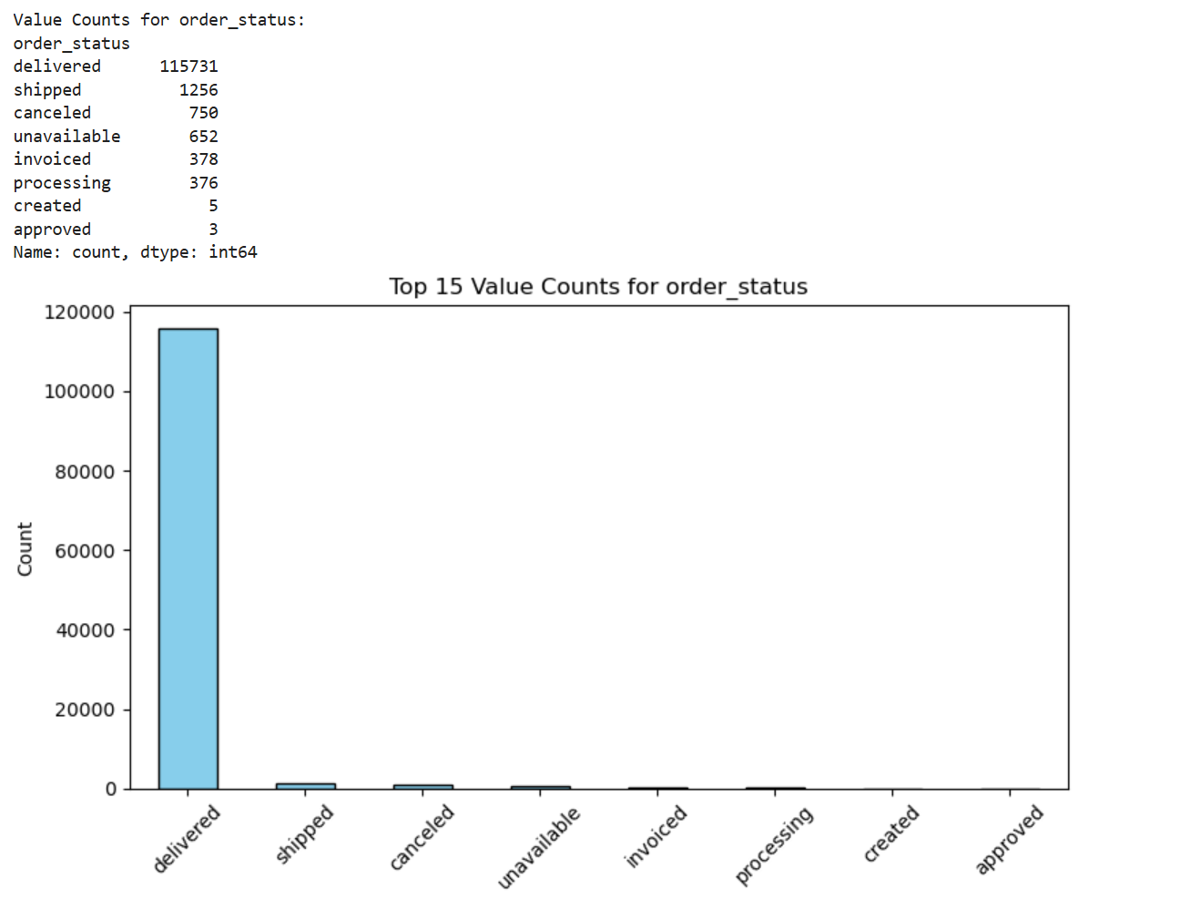
Data Analysis through Visualizations
Univariate Analysis
Order Status: The vast majority of orders are delivered, indicating strong order fulfillment performance, while cancellations and unavailable orders form only a small fraction of total transactions.

Slide 18
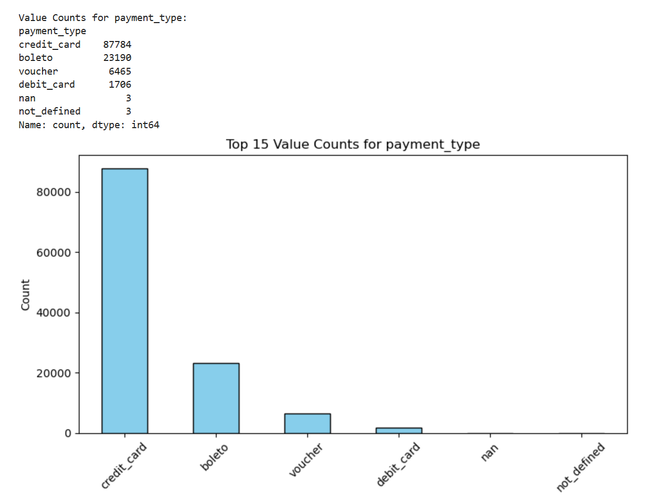
Insights from Categorical Distributions:
Payment Type: Credit cards dominate as the primary payment method, followed by bolete, showing a strong preference for card-based payments among customers.

Slide 19
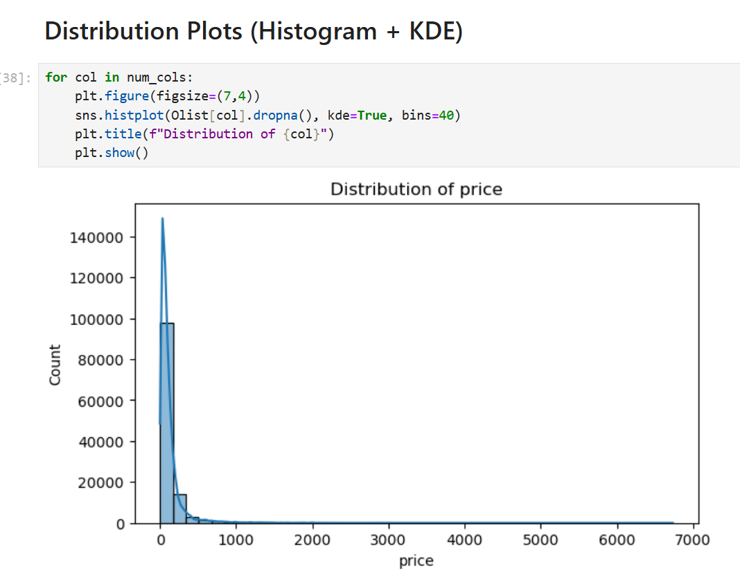
Distribution Plot Insights
Product prices and other monetary variables are highly right-skewed, with most values at the lower range and a few high-priced outliers typical of e-commerce data.

Slide 20
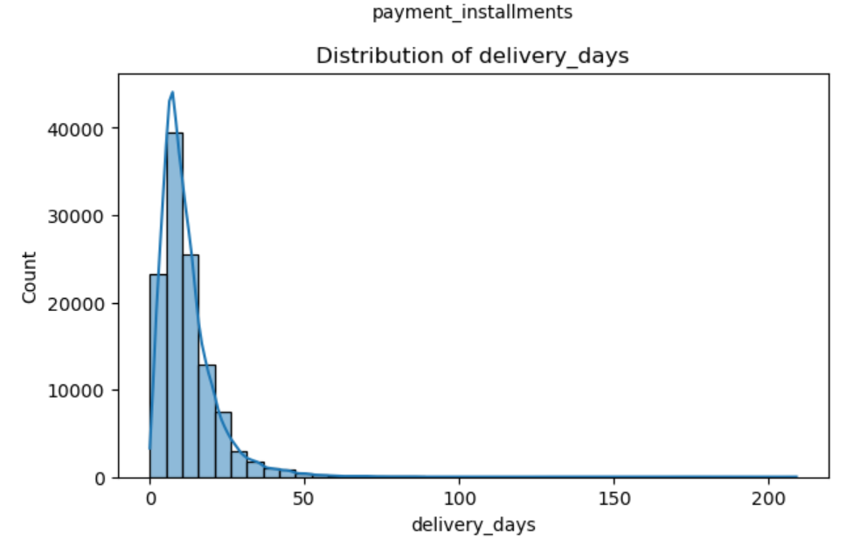
Delivery Days Distribution – Insights
Delivery time is right-skewed, with most orders delivered quickly but a long tail of delayed deliveries highlighting logistics inefficiencies that negatively impact customer satisfaction.

Slide 21
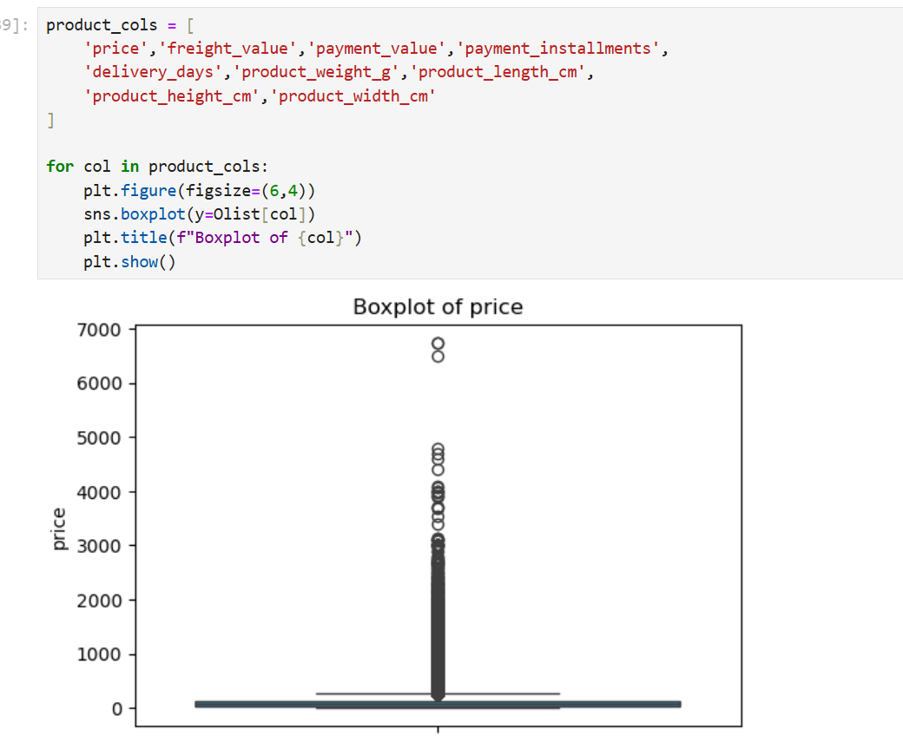
Boxplot (Outlier) Analysis
Boxplots show significant upper outliers in price, freight, delivery days, and product dimensions, reflecting real e-commerce diversity such as premium products, bulky items, and remote deliveries.

Slide 22
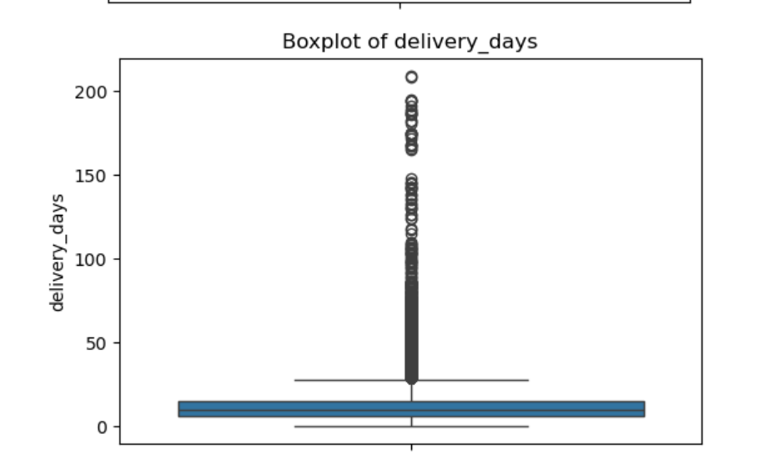
Delivery Days – Boxplot Insights
Most orders are delivered within a consistent time range, but extreme delivery delays reveal regional or seller-level logistics inefficiencies that negatively impact customer satisfaction.

Slide 23
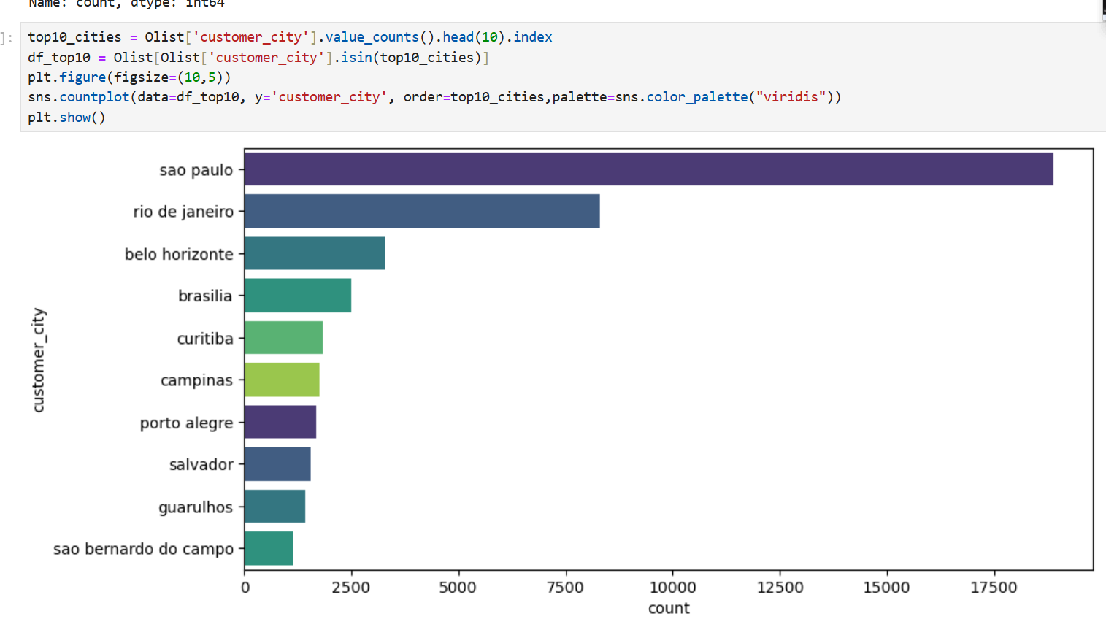
Customer City Distribution – Insights

Slide 24
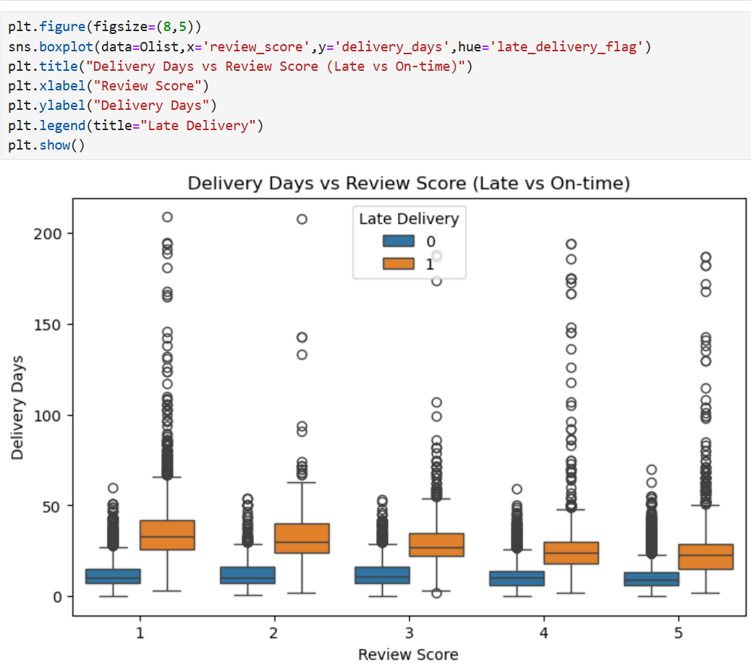
Bivariate Analysis
Delivery Days vs Review Score – Insights
Late deliveries are associated with significantly longer delivery times and lower review scores, while on-time deliveries show shorter durations and higher customer satisfaction.

Slide 25
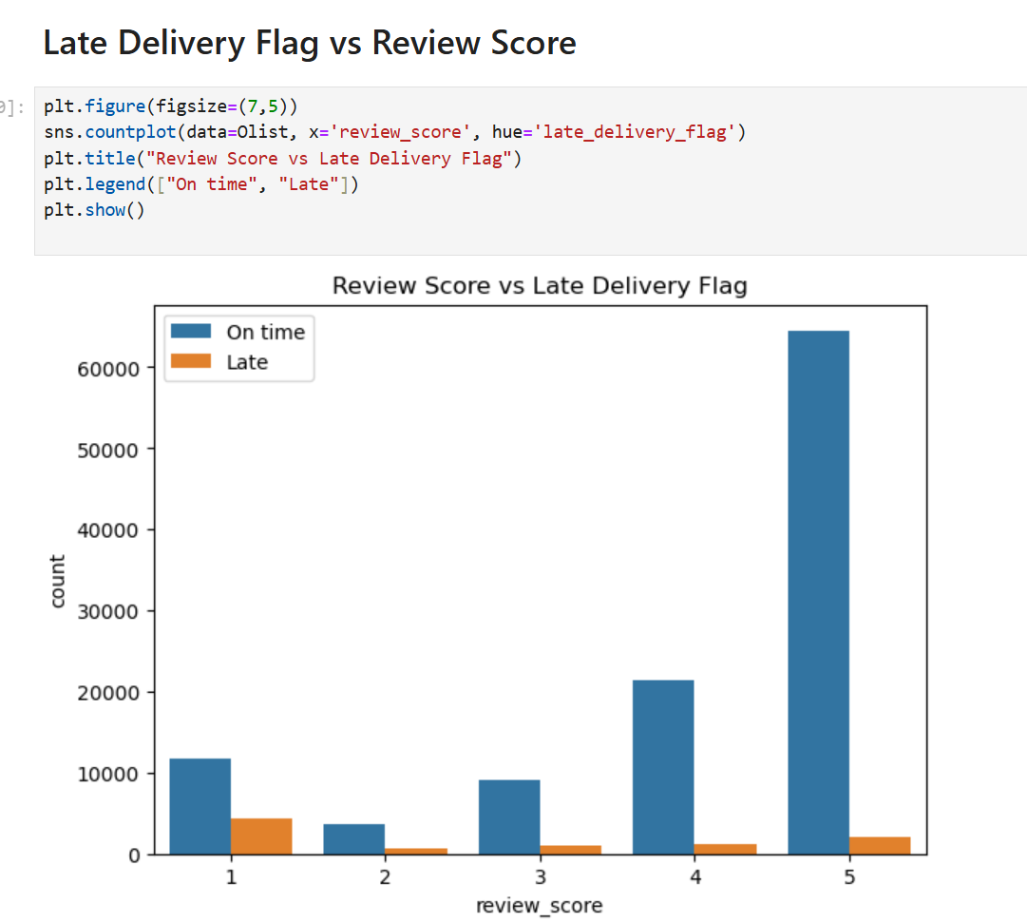
Late Delivery vs Review Score – Insights
On-time deliveries receive higher ratings while late deliveries are strongly associated with low reviews, confirming delivery timeliness as a key driver of customer satisfaction.

Slide 26
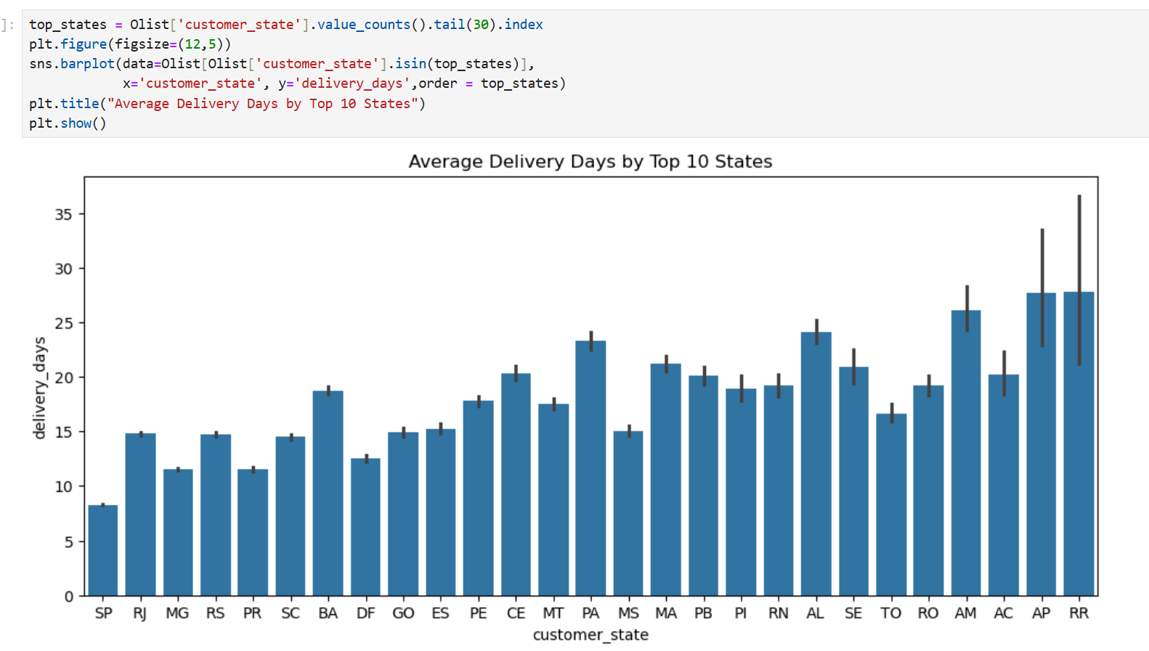
Average Delivery Days by State
States near major logistics hubs have shorter delivery times, while remote northern regions face longer deliveries due to infrastructure and distance challenges.

Slide 27
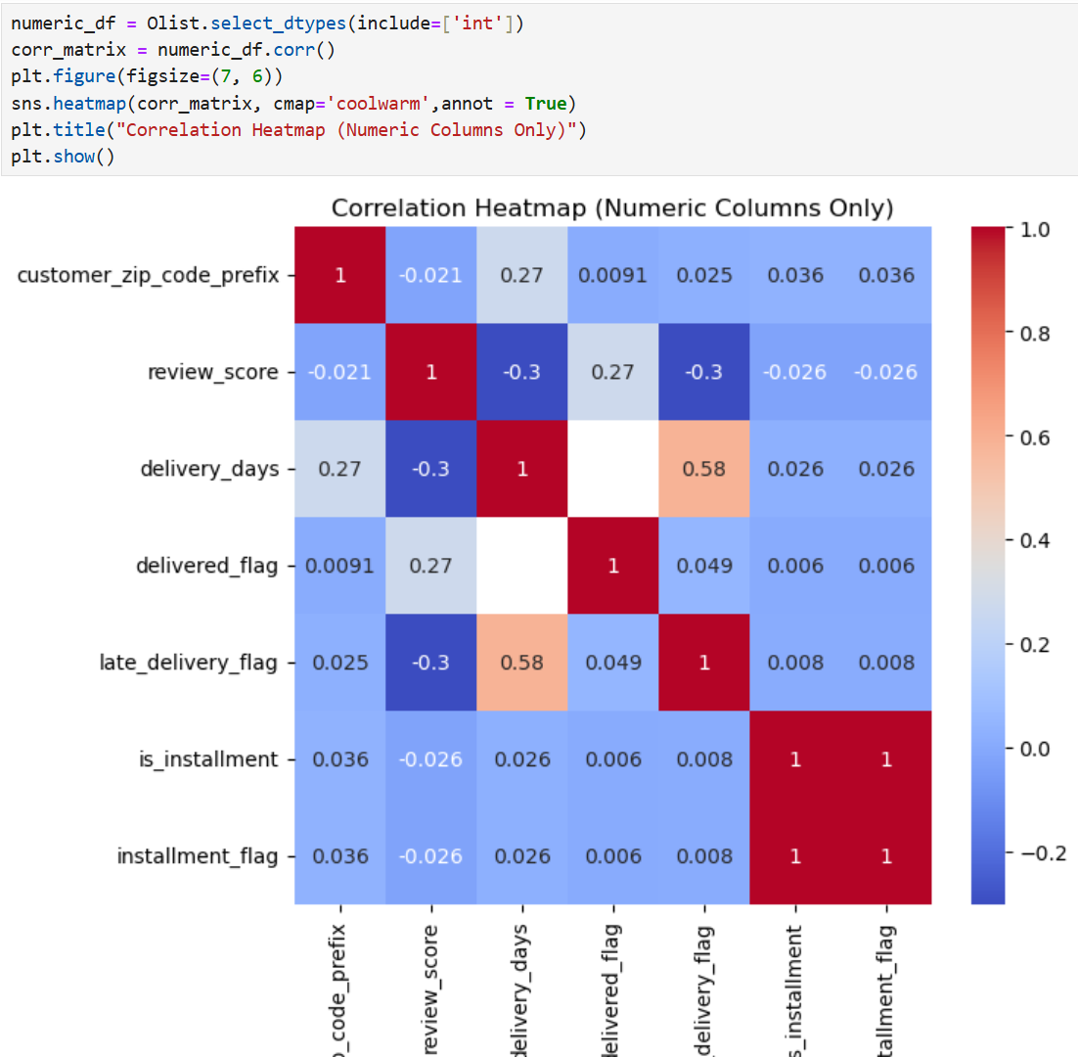
Correlation Analysis – Key Insights
Longer delivery times strongly lead to late deliveries and lower review scores, while payment behavior shows little influence on customer satisfaction.

Slide 28
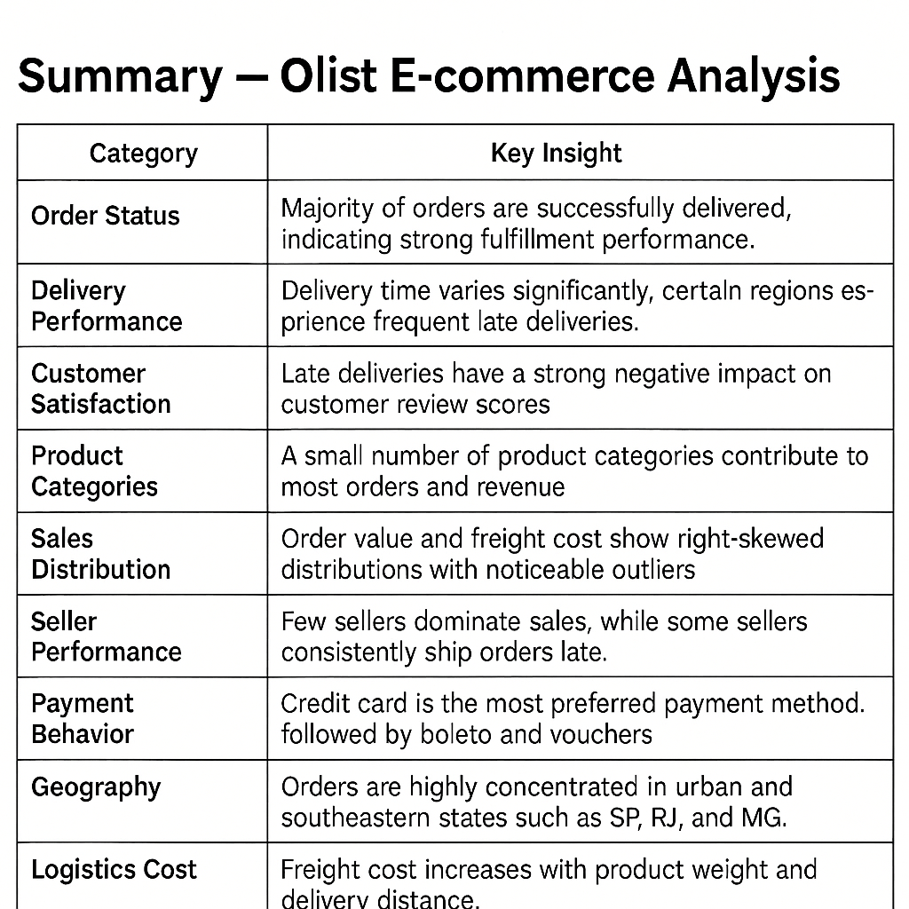

Slide 29
Conclusion – List E-commerce Analysis
The analysis provides a comprehensive view of customer behavior, seller performance, logistics efficiency, payment patterns, and product trends by integrating multiple List datasets.
Delivery performance is the most critical factor affecting customer satisfaction; late deliveries strongly lead to low review scores, especially in remote regions.
Sales follow an 80/20 pattern, where a small number of product categories and sellers generate most of the revenue.
Credit cards dominate payment methods, and higher-value orders are commonly paid in installments, with no major impact on delivery timelines.
Orders are highly concentrated in southeastern states (SP, RJ, MG), while distant regions face higher freight costs and longer delivery times.
Operational outliers in price, weight, and freight reflect real business diversity, but consistent late shipping by some sellers highlights areas for logistics optimization.

Slide 30


